Slide 1
Start
Step1
Step5
- Create empty graph G
- Define news article class
- Define news source class
- Define user class
- Create news events
*Randomly assign to a news source
*Generate sentiment randomly
*Draw a random “number of shares” from a distribution based on sentiment score
*Assign fake score based on P(sentiment and number of shares)
Step2
- Create news sources
*Bias(μ=0.5,σ=2)
*Reliability(P(reliable)=0.1)
- Add news sources to graph G
- Connect any two news sources based on a probability of similarity = P((2-Δbias)/2)
Step6
- For an event, the assigned news source publishes the event (Events happen in order. When an event that is published means the simulation has advanced one step)
- Loop through the news sources and check if any neighbor has published the news event, then based on a probability of similarity = P((2-Δbias)/2) and the reliability of the connected news source, publish the news event
- Loop through all the users and search through their recent feed of news events that is captured from their adjacent users and followed news sources
*If the user sees a new event, then predict whether the event is fake or real
and then update the classification counters *If the event is predicted to be fake, set a very small probability P(0.01) that it will be shared by the user. Otherwise, set a larger probability P(0.1) that it will be shared
Step3
- Create users
*Bias(μ=0,σ=2)
*Analytical & Motivated (P(A&M)=0.05)
*Classifier = Default trained classifier
- Add users to graph G
- User follows a news sources based on two probabilities: probability of similarity = P((2-Δbias)/2) AND
probability of random connection = P(0.01)
Step4
User initially connects to any other user under a very small probability = P(0.005)
User connects to an indirectly connected user through their mutual connections based on a random probability in an iterative process until average degree of graph G is achieved

Slide 2
Start
Create empty graph and add news sources. Connect news sources based on their similarity
Create E news events (e=1, E)
Add users to the graph. Connect the users to each other and to news sources in an iterative process that aims at creating communities
New event shared by its original news source. The source’s neighbors find the news article in their feed
News sources share the news event based on their reliability and based on similarity. The list of neighbors may expand upon sharing
Users classify the news event they have not seen. They also might share based on a share probability. The list of neighbors may expand upon sharing
e <=E
Yes
No
End

Slide 3
Start
Create the Social Network Model based using one of the algorithm that determines the shape of the communities that make the network
Create E news events (e=1, E)
New event shared by its original source. The source’s neighbors find the news article in their feed
News sources share the news event based on their reliability and based on similarity. The number of viewers may expand upon sharing
Users classify the news event they have not seen. They also might share based on a share probability. Data on sharing the news is collected.
e <=E
Yes
No
End

Slide 4
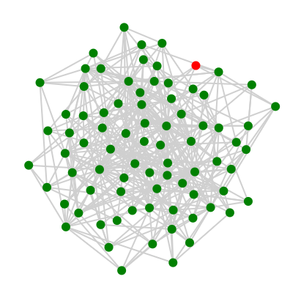
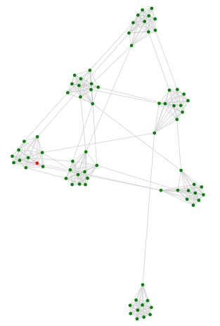
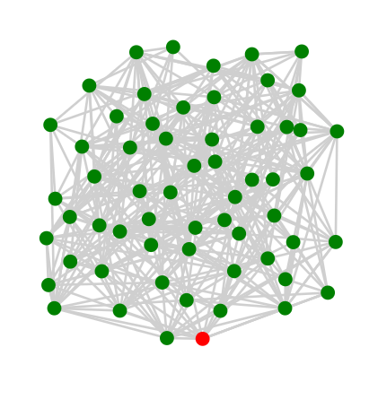
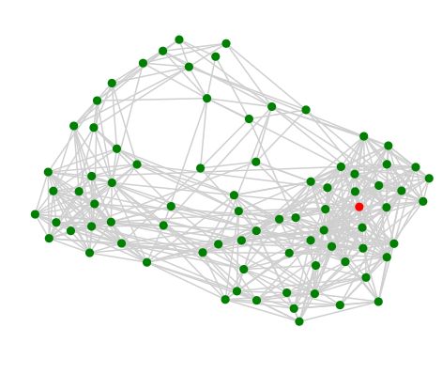
Power Law Cluster Graph
Few Influencers
No Cliques
Relaxed Caveman Graph
Cliques of highly dense connections
No network Influencers
Gaussian Random Partition Graph
Clusters can be set with a mean and variance
Inter and intra cluster connections can be configured
Spectral Graph Forge
Can use a real social network graph and create a graph with a similar eigen structure
The ratio of eigenvectors similar to the original graph can be configured

Slide 5
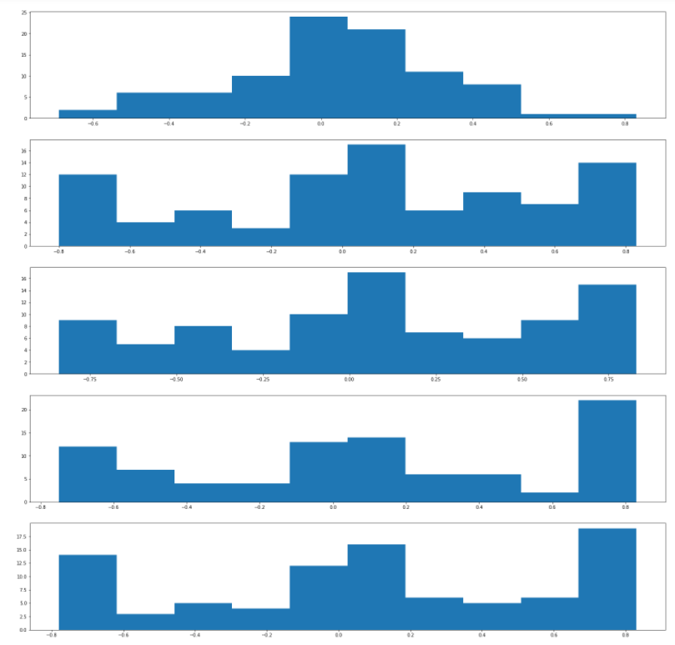
Total number of nodes 100
Probability of generating fake news = 10%
Regular users started with a normal distribution of preference and uniform distribution of sharing tendencies
90% of news agencies were considered unreliable and can generate fake news
The network policy recommended news with most shocking value and agree with the user’s preferences
Histogram of regular user preferences over time
t=0, μ=0.04, σ=0.27
t=100, μ=0.08, σ=0.47
t=200, μ=0.08, σ=0.49
t=300, μ=0.1, σ=0.49
t=400, μ=0.09, σ=0.5
% fake news shared = 33%
% real news shared = 67%

